Slide 1
Aspect Oriented Programming
AOP
July - 2021

Slide 2
Summary
AOP. Basics
AOP. Demo
Bibliography

Slide 3
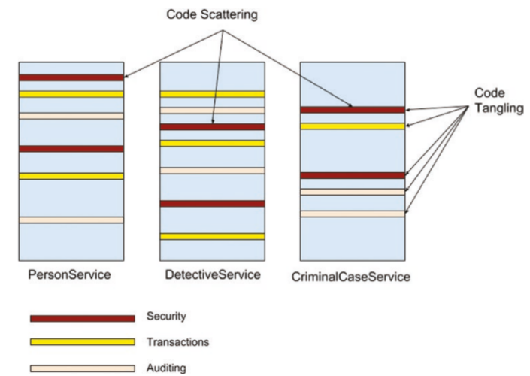
1. Basics
AOP (Aspect Oriented Programming) is a paradigm used to separate business-logic from cross-cutting concerns (Logging, Security, Transactions, Caching…)
AOP complements OOP by injecting Aspects into the objects.

Slide 4
Terminology
Aspect: class with the Advices (related to a concern: Logging, Security…).
ASPECT = POINTCUT (pattern) + ADVICE (code)
Pointcut: pattern to identify Joinpoints, where execute the advice.
Advice: code executed by an aspect in a Joinpoint.
Joinpoint: method to be executed.
Weaving: linking Aspects to Joinpoints (by wrapping with AOP-proxies).

Slide 5
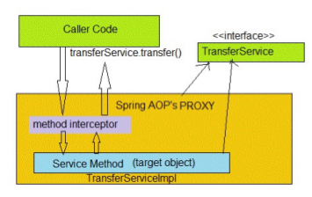
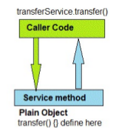
AOP-Proxy
Proxies wrap the Pointcuts (methods) adding the new logic (Advices).
2 types: JDK-dynamic-proxy, CGLIB-proxy
AOP

Slide 6
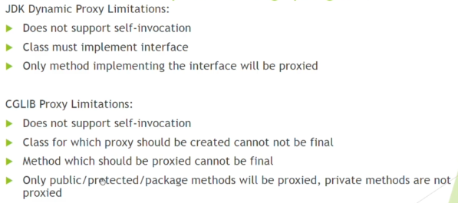
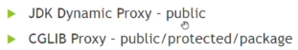
AOP-Proxy (II)
JDK-dynamic-proxy: used by default in Spring-AOP (to proxy interfaces)
CGLIB-proxy: used when the class does not implement interface.

Slide 7
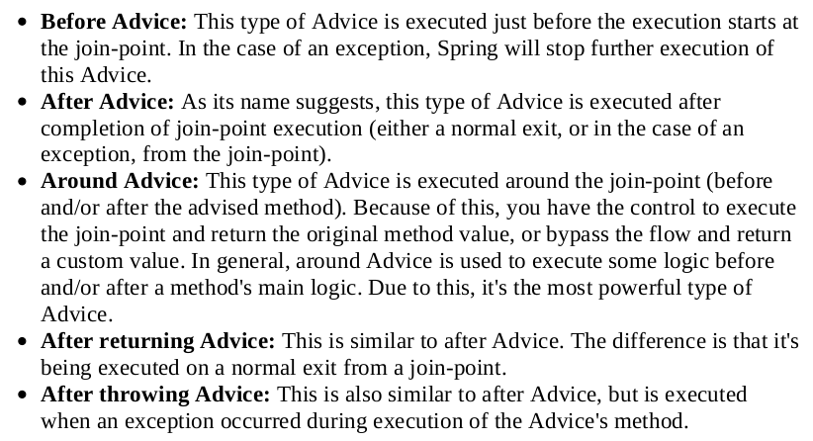
Advice
Advice: the code executed by an Aspect at a particular Joinpoint.
[Spring-AOP] @Before, @After, @AfterReturning, @AfterThrowing, @Around.

Slide 8
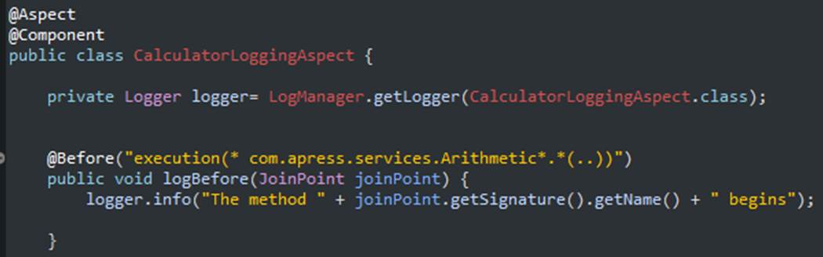
Advice (II)
Advice

Slide 9
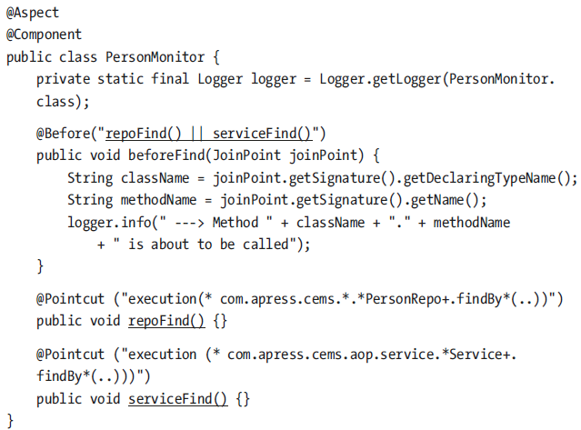
Pointcut
Pointcut: pattern to select in which Joinpoints will be executed the Advice.
[Spring-AOP] @Pointcut
Combined Pointcut
Pointcut

Slide 10
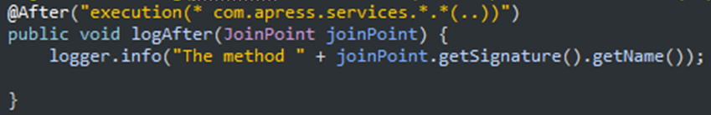
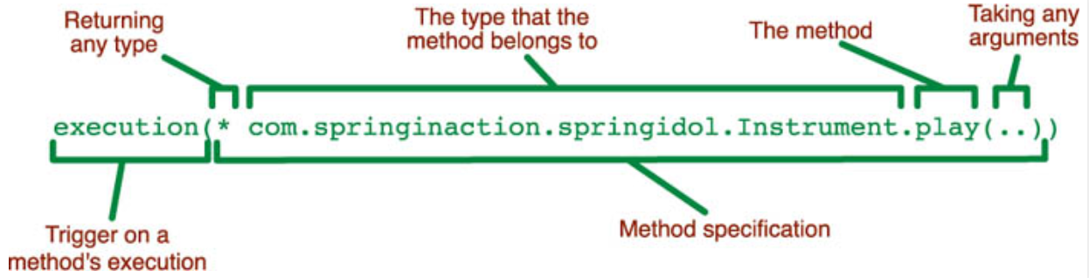
Pointcut (II)
- Pointcut expressions: [Spring-AOP] execution, within, this, target, args, @target, @args, @within, @annotation
execution: matches method
within: matches types inside a package
@annotation: matches Joinpoints (methods) with the annotation
Etc…

Slide 11
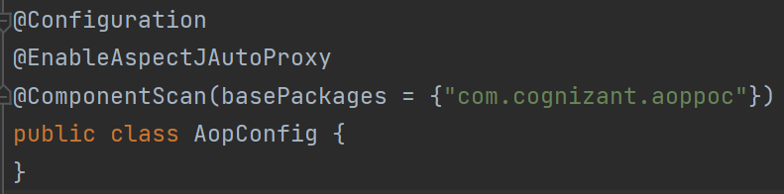
Spring-AOP configuration
Spring-AOP: runtime-weaving and only applied to methods.
@EnableAspectJAutoProxy
SpringAOP vs AspectJ: AspectJ is compile-time and is used for more complex necessities.
Spring-Boot configuration [POM.xml]: spring-boot-starter-aop

Slide 12
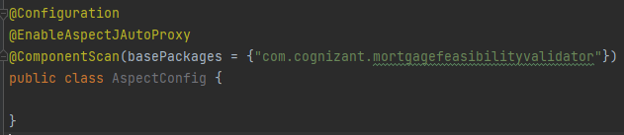
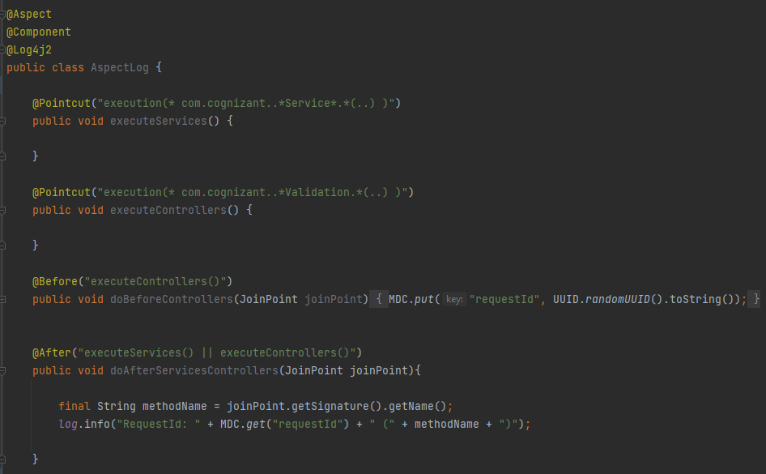
2. Demo

Slide 13


3. Bibliography
Introduction to Spring-AOP https://www.baeldung.com/spring-aop
AOP with Spring https://docs.spring.io/spring-framework/docs/2.5.x/reference/aop.html
Aspect Oriented Programming with Spring AOP [Pluralsight]
Logging with Spring-AOP [Coursera]

Slide 14
Thank you
Reference-Architecture project
By Felix Mellado and Hugo Mozo

Slide 15


